Slide 1



Getting Grant ready

Slide 2

Shire of gingin
community grants program
What is it?
Financial support from the Shire to local community groups for projects and events planned for next financial year (June 2023- July 2024).
It is offered once per year - opens 1 February and closes 31 March 2022.
Application outcomes will be confirmed by end of August 2023.
Four funding
streams available
Public Liability Insurance – runs in 3-year cycles, up to 50% annual premium up to max $500.
Community Project/Event – up to $10,000 ex GST.
Funding Assistance Scheme – runs in 3-year cycles, larger projects that are ongoing
Council Budget Request – over $10,000 ex GST.
Who can apply?
Any incorporated not-for-profit group or organisation in Shire of Gingin.
Unincorporated groups auspiced by another incorporated organisation. Bushfire Volunteer Groups are ineligible as the Shire provides financial support through other avenues.
Notes:
WHAT IS IT? Each year, the Shire provides financial support to local community organisations and groups for projects and events planned for the following financial year (July 2022-June 2023). This year’s funding round opens 7 February and closes 19 March. Applicants are notified on the outcome of their application by the end of August. Please note that grant funds can only be used to cover purchases made after funding is confirmed.
FOUR FUNDING STREAMS
1. Public Liability Insurance is important for groups to have, but it can be expensive. This grant is available to cover 50% of a group’s Public Liability Insurance up to a maximum of $500.
2. Community Projects/Events (up to $10,000) This grant is available for events and projects that support the Shire’s five focus areas for enabling a thriving community. If your project involves upgrades to public areas or buildings, please contact us prior to applying to discuss if any additional information will be required.
3. Funding Assistance Scheme (not currently open) This grant runs in three-year cycles and is for ongoing activities such as environmental restoration. This stream will be taking applications again in February 2023.
4. Council Budget Requests (over $10,000) For larger projects seeking funds over $10,000 (including fixed infrastructure/asset projects), a Council Budget Request is required so it can form part of the Shire’s Annual Budget for the next financial year. More information about Council Budget Requests can be found in the Guidelines & Application form which we have copies here or visit the Funding & Grants page on our website.
WHO CAN APPLY? Funding can be applied for by any incorporated not-for profit group or community organisation within the Shire of Gingin. If you aren’t incorporated, you can link with another incorporated community organisation to auspice your application. An example of that might be…

Slide 3
Shire of Gingin community grants program
Funding Focus Areas
These come from the Shire’s Strategic Community Plan which is developed in consultation with community.
Applications are assessed on how well they align with the following focus areas:
Attractions & Economy:
Attractions & Events
Food Bowl Sub Region
Infrastructure investment
2. Connections & Wellbeing
Community Safety & Support
Services & Facilities
Youth Investment
3. Planning & Sustainability
Preservation and management of Endangered Habitat & Coastal Reserves
Planning & land use
Energy Alternatives
4. Excellence & Accountability
Management of existing assets
Information Sharing
Effective Governance
Notes:
Attractions & Economy: Actively Pursue Tourism and Economic Development
Connects & Wellbeing: Grow and Nurture Community Connectedness and Wellbeing
Planning & Sustainability: Plan for Future Generations
Excellence & Accountability: Deliver Quality Leadership and Business Expertise

Slide 4
Shire of Gingin community grants program
Notes:
Examples of past community projects and events funded by the Shire and their funding streams.

Slide 5
Shire of Gingin community grants program
Eligibility
Project/event must be in the Shire of Gingin.
Be an incorporated not-for-profit, or group that is auspiced by a not-for-profit.
Support one or more of the Shire’s funding focus areas.
For Concept Enquiries (infrastructure/asset related projects) – have received a Shire in-principle Letter of Support.
Notes:
Eligibility:
Project or event must be undertaken within the Shire of Gingin’s local government boundaries.
Be organised by an incorporated not-for-profit organisation, or group that is auspiced by a not-for-profit organisation.
Support one or more of the Shire’s funding focus areas.
If your proposed project is for new fixed infrastructure or additions, alterations and/or improvements to existing Shire infrastructure/assets then you will need to seek Shire approval in the first instance via a Concept Enquiry. More information can be provided on the Concept Enquiry process if required.

Slide 6
Shire of Gingin community grants program
What the Shire doesn’t fund…
Consumables - eg, office supplies.
Core operating costs - eg, wages.
Commercial activities or business.
Projects with a political or religious purpose only.
Retrospective costs -
Projects that duplicate existing Shire services or are already covered by existing service agreements.
Maintenance to Shire buildings.
Notes:
What the Shire Doesn’t Fund:
Operational consumables (including printing inks, office supplies)
Core organisational operating costs, for example a permanent position for ongoing work (e.g. wages, staff)
Commercial activities of businesses and organisations
Projects with a political or religious purpose only
Retrospective costs - eg, project/event already commenced or completed
Projects that duplicate existing Shire services and programmes or activities that are already covered by existing service agreements with the Shire of Gingin
Maintenance to Shire buildings (these items are identified during infrastructure inspections and during maintenance assessments).

Slide 7
Shire of Gingin community grants program
How we evaluate
Council asks 6 questions when assessing each funding application:
How does the project support the community funding focus areas?
What is the benefit to community?
Which part of the community will benefit?
Does the applicant have the experience/support needed to complete the project?
What in-kind or cash support is being provided by the applicant or other funding partners towards the project?
Is the cost of the project reasonable for the benefits created?
Notes:
Council asks six questions when it assesses each funding application:
How does the project support the community funding focus areas?
What will the benefit be for the community?
Which part of the community will benefit?
Does the group have the experience/support needed to complete the project?
What in-kind or cash support is being provided by the applicant or other funding partners towards the project?
Is the cost of the project reasonable for the benefits created?

Slide 8
Shire of Gingin community grants program
How to apply
Application forms & accompanying guidelines for all 4 funding streams are available on the Shire’s website www.gingin.wa.gov.au/funding-and-grants or by contacting the Shire’s Community Services team at grants@gingin.wa.gov.au.
Complete the application form relevant to your project or event – ensure you understand each question and answer to the best of your ability.
Return your application to the Shire’s Community Services team.
The Community Services team are more than happy to answer any queries!
Notes:
How to Apply:
Application forms & accompanying guidelines for all 4 funding streams are available on the Shire’s website or by contacting the Shire’s Community Services team at grants@gingin.wa.gov.au.
Complete the application form relevant to your project or event – ensure you understand each question and answer to the best of your ability.
Return your application to the Shire’s Community Services team.
The Community Services team are more than happy to answer any queries!

Slide 9
Shire of Gingin community grants program
Supporting documentation
The following documents may be required to support your application:
Current Certificate of Incorporation (if not supplied previously)
Most recent bank and/or financial statements
Copy of Insurance Certificate of Currency
Most recent invoice for Public Liability Insurance
Committee Minutes with motion approving project/event
Stakeholder and/or community letter of support
Shire In-Principle Letter of Support (for Concept Enquiry projects)
Quotations
Notes:
The following documents may be required to support your application:
Current Certificate of Incorporation (if not supplied previously)
Most recent bank and/or financial statements
Copy of Insurance Certificate of Currency
Most recent invoice for Public Liability Insurance
Committee Minutes with motion approving project/event
Stakeholder and/or community letter of support
Shire In-Principle Letter of Support (for Concept Enquiry projects)
Quotations

Slide 10
Shire of Gingin community grants program
If your application is successful…
You will be notified in writing by the Shire of your successful application.
You will receive 50% of approved funding prior to project commencement – invoice the Shire for this amount.
You will receive the remaining 50% on receipt of your acquittal and project completion – invoice the Shire for this amount.
Notes:
If your application is successful:
You will be notified in writing by the Shire that your application has been successful.
You will receive 50% of approved funding prior to project commencement – just need to invoice the Shire for this amount.
You will receive the remaining 50% on receipt of your acquittal and project completion – invoice the Shire for this amount.

Slide 11
Shire of Gingin community grants program
Timeline
Date | Deadlines | Action
February | First Monday in February | Shire Community Grants Program opens
March | Third Friday in March | Shire Community Grants Program closes
April – July |  | Council assessment of applications Adoption of Annual Budget
August | Last business day in August | Letter sent advising outcome of application
September | Last Friday in September | Deadline for returning Funding Agreement by successful applicants
May | Last business day in May | Project/event acquittal & final invoice due
Notes:
The timeline here is an overview of what is required and when

Slide 12
Getting ACQUITTAL ready

Slide 13

Shire of Gingin community grants program
Acquittal Process
Acquitting a grant means accurately reporting on the funded activities and the expenditure of the funding. Grant acquittal reports are required on completion of your project, and are used to confirm the following: that the funding has been used for the purpose intended in the funding application and the terms of the funding agreement have been met.
What to include in it
Photos of project/event
Promotional material for the project/event showing inclusion of Shire logo
Receipts of purchases
Copies of invoices paid

Slide 14
Shire of Gingin community grants program
When to Start
Your acquittal will be due 31 May 2024.
You can start the acquittal process straight away by saving documentation electronically or printing:
copies of receipts from purchases or invoice payments
Posters of event/project
Advertising done on the event – Social media posts, newspaper cuttings
Photos of progress shots (if not an event)
Photos of the event
Feedback from community after event

Slide 15
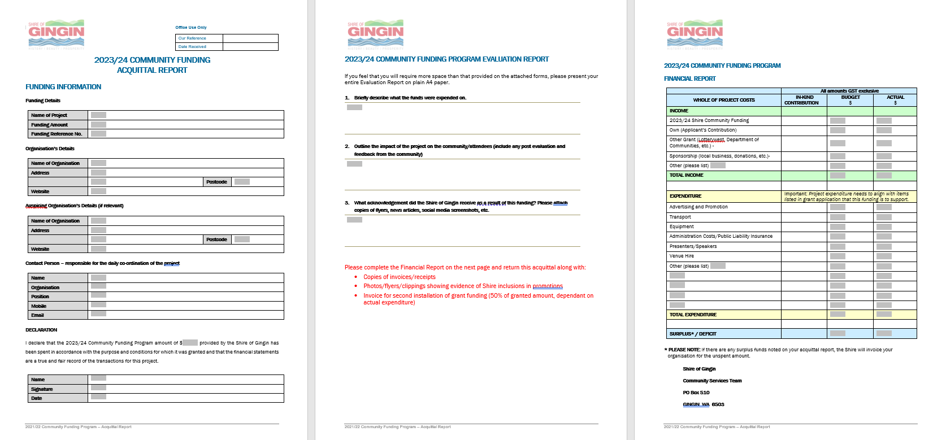
Shire of Gingin community grants program
Acquittal Form
The acquittal form will be provided to you at approval of your grant and in email reminders. You can also request a form at grants@gingin.wa.gov.au
The Acquittal form will ask questions like:
Organisation details
Contact person
Declaration to sign
Few questions about what the funds were used on, how the project went, evidence of the project/event
Table to list income and expenditure

Slide 16
Thank
You
Any questions contact the grants team on grants@gingin.wa.gov.au

